Slide 1

Chapter 15 Part 1
Database Connectivity and Web Technologies
The slides in this presentation have been adapted from slides provided with the textbook, Database Systems: Design, Implementation, and Management,
12E, Cornel and Morris, Copyright © 2017 Cengage Learning.

Slide 2
Learning Objectives
About various database connectivity technologies
How Web-to-database middleware is used to integrate databases with the Internet
Copyright © 2017 Cengage Learning
2

Slide 3
Database Connectivity
Database middleware: Provides an interface between the application program and the database
Data repository - Data management application used to store data generated by an application program
Universal Data Access (UDA): Collection of technologies used to access any type of data source and manage the data through a common interface
ODBC, OLE-DB, ADO.NET form the backbone of MS UDA architecture
Copyright © 2017 Cengage Learning
3

Slide 4
Database Internet Connectivity
Allows new innovative services that:
Permit rapid response by bringing new services and products to market quickly
Increase customer satisfaction through creation of web-based support services
Allow anywhere, anytime data access using mobile smart devices via the Internet
Yield fast and effective information dissemination through universal access
Copyright © 2017 Cengage Learning
4

Slide 5
Characteristics and Benefits of Internet Technologies
Hardware and software independence
Savings in software equipment and acquisition
Ability to run on existing equipment
Platform independence and portability
No need for multiple platform development
Common and simple user interface
Reduced training time and cost
Reduced end-user support cost
No need for multiple platform development
Copyright © 2017 Cengage Learning
5

Slide 6
Characteristics and Benefits of Internet Technologies
Location independence
Global access and reduced requirements for dedicated connections
Rapid development at manageable costs
Availability of plug-and-play and interactive development tools
Reduced costs and development times
Relatively inexpensive tools
Free client access tools
Distributed processing and scalability
Copyright © 2017 Cengage Learning
6

Slide 7
Native SQL Connectivity
Connection interface provided by database vendors
Unique to each vendor
Example: Oracle RDBMS
Must install and configure Oracle’s SQL*Net interface in client computer
Interfaces optimized for particular vendor’s DBMS
Maintenance is a burden for the programmer
Copyright © 2017 Cengage Learning
7

Slide 8
ODBC, DAO, and RDO
Open Database Connectivity (ODBC):Microsoft’s implementation of a superset of SQL Access Group Call Level Interface (CLI) standard for database access
Widely supported database connectivity interface
Allows Windows application to access relational data sources by using SQL via standard application programming interface (API)
Copyright © 2017 Cengage Learning
8

Slide 9
ODBC, DAO, and RDO
Data Access Objects (DAO): Object-oriented API used to access MS Access, MS FoxPro, and dBase databases from Visual Basic programs
Provides an optimized interface that expose functionality of Jet data engine to programmers
DAO interface can be used to access other relational style data sources
Copyright © 2017 Cengage Learning
9

Slide 10
ODBC, DAO, and RDO
Remote Data Objects (RDO)
Higher-level object-oriented application interface used to access remote database servers
Dynamic-link libraries (DLLs)
Implements ODBC, DAO, and RDO as shared code that is dynamically linked to the Windows operating environment
Copyright © 2017 Cengage Learning
10

Slide 11
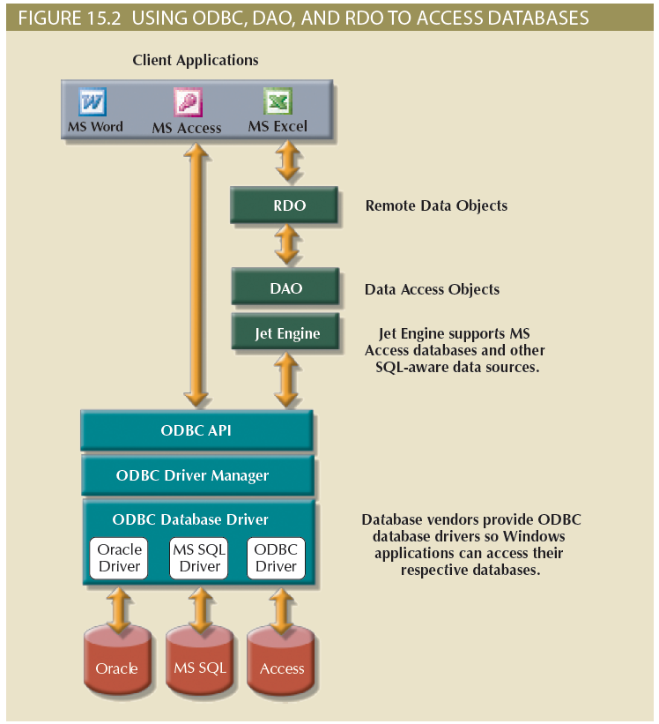
Copyright © 2017 Cengage Learning
11

Slide 12
Components of ODBC Architecture
High-level ODBC API through which application programs access ODBC functionality
Driver manager that is in charge of managing all database connections
ODBC driver that communicates directly to DBMS
Copyright © 2017 Cengage Learning
12

Slide 13
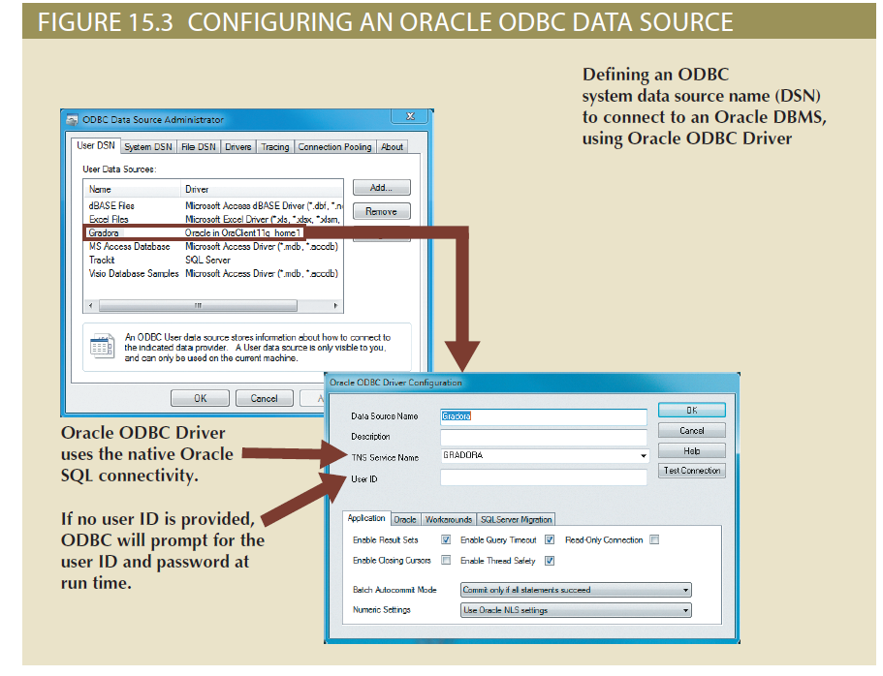
Copyright © 2017 Cengage Learning
13

Slide 14
Object Linking and Embedding for Database (OLE-DB)
Database middleware that adds object-oriented functionality for access to data
Series of COM objects provides low-level database connectivity for applications
Types of objects based on functionality
Consumers
Providers
Does not provide support for scripting languages
Copyright © 2017 Cengage Learning
14

Slide 15
Object Linking and Embedding for Database (OLE-DB)
ActiveX Data Objects (ADO): Provides:
High-level application-oriented interface to interact with OLE-DB, DAO, and RDO
Unified interface to access data from any programming language that uses the underlying OLE-DB objects
Copyright © 2017 Cengage Learning
15

Slide 16
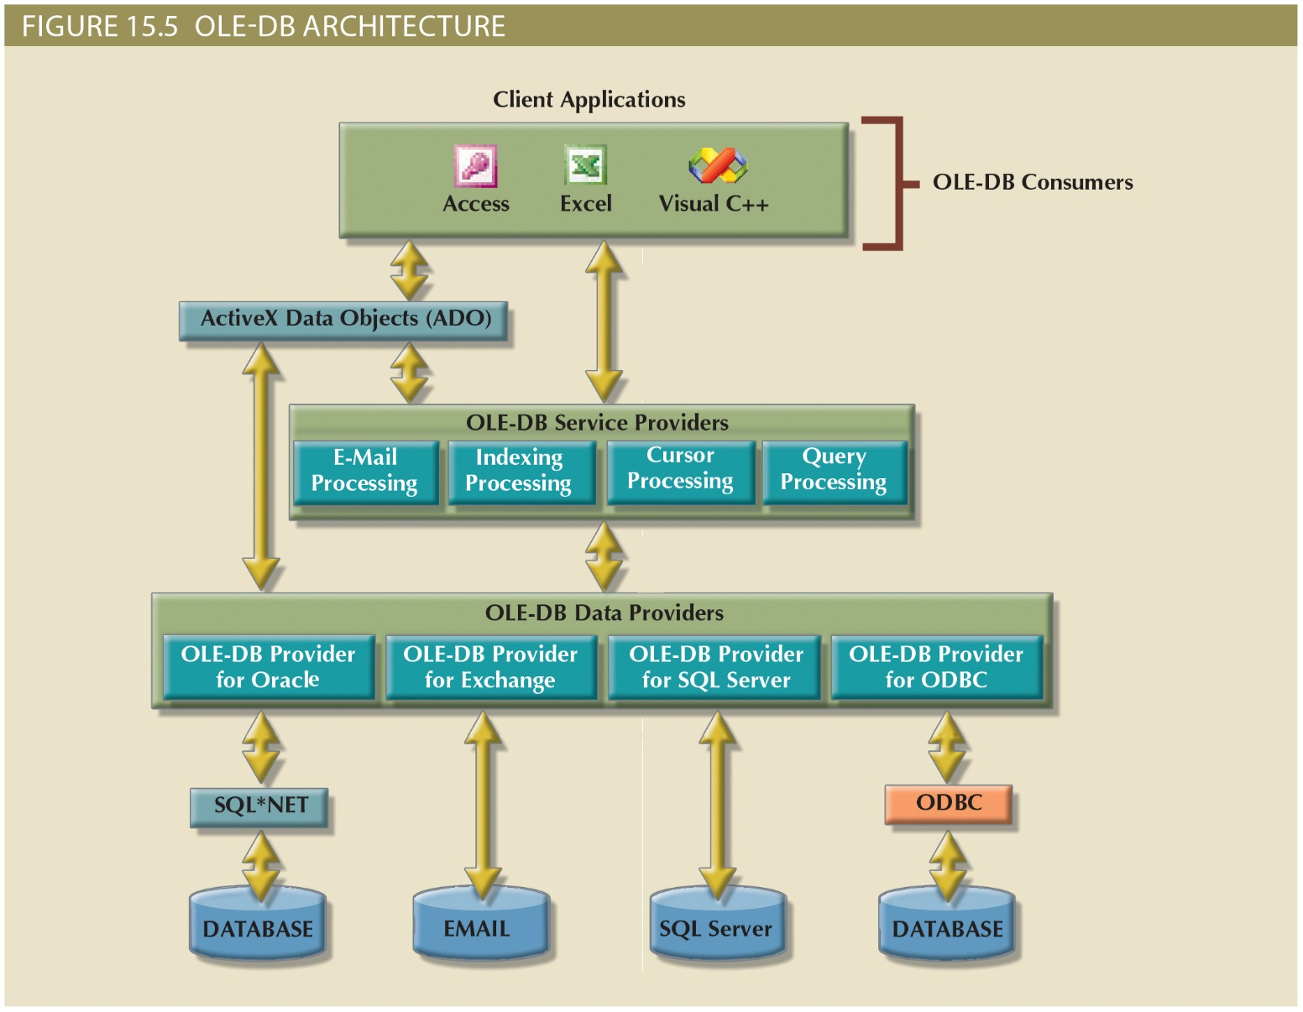
Copyright © 2017 Cengage Learning
16

Slide 17
ADO.NET
Data access component of Microsoft’s .NET application development framework
Microsoft’s .NET framework
Component-based platform for developing distributed, heterogeneous, interoperable applications
Manipulates any type of data using any combination of network, operating system, and programming language
Copyright © 2017 Cengage Learning
17

Slide 18
ADO.NET
Features critical for the development of distributed applications
DataSet: Disconnected memory-resident representation of database
XML support
DataSet is internally stored in XML format
Data in DataSet is made persistent as XML documents
Copyright © 2017 Cengage Learning
18

Slide 19
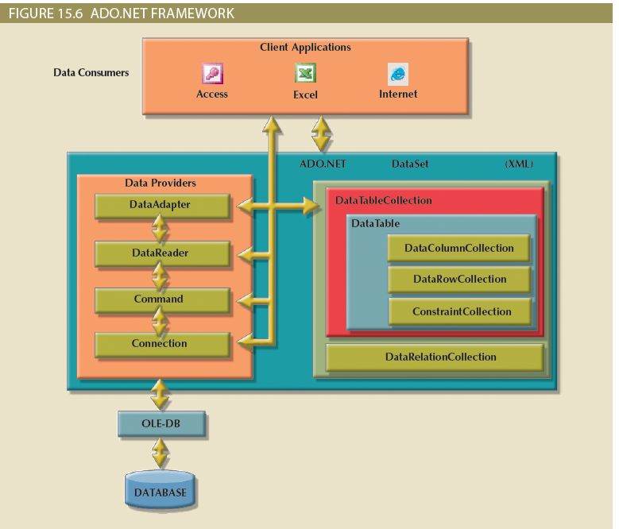
Copyright © 2017 Cengage Learning
19

Slide 20
Summary
Database connectivity:
Ways in which programs connect and communicate with data repositories
Database repository also known as data source
Represents data management application used to store data generated by the program
Microsoft interfaces are dominant players
ODBC, OLE-DB, ADO.NET
Copyright © 2017 Cengage Learning
20

Slide 21
Task
Describe how a connection between the database and a Java application is created.
Copyright © 2017 Cengage Learning
21

